Slide 1
Software Engineering Lecture 4
By
Engr. Sara Rehmat
MS (CS)

Slide 2
Specialized Process Models
Component based development
Formal Methods
Unified Process

Slide 3
Specialized Process Models
Component based development—the process to apply when reuse is a development objective.
Commercial off-the-shelf (COTS) software components, developed by vendors who offer them as products, provide targeted functionality with well-defined interfaces that enable the component to be integrated into the software that is to be built.
E.g., most anti-virus programs, games and even computer utilities, , such as word processors, database managers, spreadsheet creators.

Slide 4
Component Based Development
Available component-based products are researched and evaluated for the application domain in question.
Component integration issues are considered.
A software architecture is designed to accommodate the components.
Components are integrated into the architecture.
Comprehensive testing is conducted to ensure proper functionality.
Your software engineering team can achieve a reduction in development cycle time as well as a Reduction in project cost if component reuse becomes part of your culture.

Slide 5
Formal Methods
The formal methods model encompasses a set of activities that leads to formal mathematical specification of computer software.
Formal methods enable you to specify, develop, and verify a computer-based system by applying a rigorous, mathematical notation.
A variation on this approach, called cleanroom software engineering is currently applied by some software development organizations.
Used in safety critical systems e.g., developers of aircraft avionics and medical devices

Slide 6
Disadvantages of Formal Methods
The development of formal models is currently quite time consuming and expensive.
Because few software developers have the necessary background to apply formal methods, extensive training is required.
It is difficult to use the models as a communication mechanism for technically unsophisticated customers.

Slide 7
Unified Process
Unified Process—a “use-case driven, architecture-centric, iterative and incremental” software process closely aligned with the Unified Modeling Language (UML).
Unified Process is an attempt to draw on the best features and characteristics of traditional software process models, but characterize them in a way that implements many of the best principles of agile software development.

Slide 8
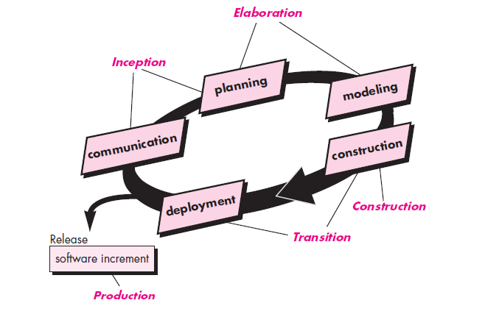
Phases of Unified Process

Slide 9
Unified Process
Inception:
By collaborating with stakeholders, business requirements for the software are identified; a rough architecture for the system is proposed; and a plan for the iterative, incremental nature of the ensuing project is developed.
Fundamental business requirements are described through a set of preliminary use cases that describe which features and functions each major class of users desires.
Planning identifies resources, assesses major risks, defines a schedule, and establishes a basis for the phases that are to be applied as the software increment is developed.

Slide 10
Unified Process
Elaboration: expands the architectural representation to include five different views of the software—the use case model, the requirements model, the design model, the implementation model, and the deployment model.
Construction: All necessary and required features and functions for the software increment are then implemented in source code.
As components are being implemented, unit tests are designed and executed for each. In addition, integration activities (component assembly and integration testing) are conducted. Use cases are used to derive a suite of acceptance tests that are executed prior to the initiation of the next UP phase.

Slide 11
Unified Process
Transition:
Later Stages of construction + delivery + feedback
The software team creates the necessary support information (e.g., user manuals, troubleshooting guides, installation procedures) that is required for the release. At the conclusion of the transition phase, the software increment becomes a usable software release.
Production:
Deployment + Maintenance

Slide 12
Unified Process
The UP recognizes that conventional process models present a single view of the process. In contrast, the RUP is normally described from three perspectives:
A dynamic perspective, which shows the phases of the model over time.
A static perspective, which shows the process activities that are enacted.
A practice perspective, which suggests good practices to be used during the process.

Slide 13
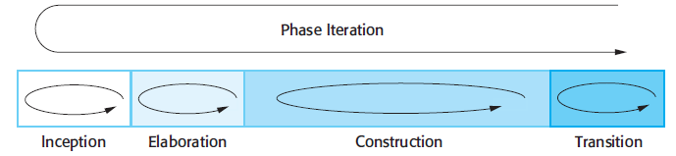
Dynamic Perspective of UP

Slide 14
Static Perspective of UP
A software engineering workflow is distributed across all UP phases.
In the context of UP, a workflow is analogous to a task set.
That is, a workflow identifies the tasks required to accomplish an important software engineering action and the work products that are produced as a consequence of successfully completing the tasks.

Slide 15
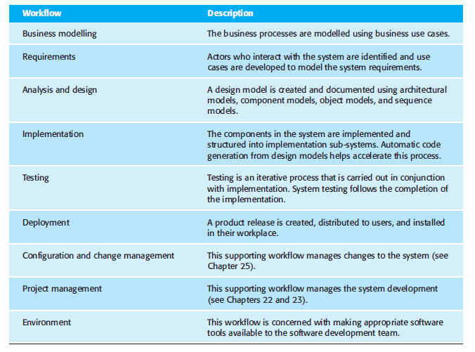
Static Perspective of Unified Process – Software Engineering Workflows

Slide 16
A practice perspective
Develop software iteratively
Plan increments of the system based on customer priorities and develop the highest-priority system features early in the development process.
Manage requirements
Explicitly document the customer’s requirements and keep track of changes to these requirements. Analyze the impact of changes on the system before accepting them.
Use component-based architectures
Structure the system architecture into components,
Visually model software Use graphical UML models to present static and dynamic views of the software.
Verify software quality Ensure that the software meets the organizational quality standards.
Control changes to software Manage changes to the software using a change management system and configuration management procedures and tools.

Slide 17
Agile Methods
The Manifesto for Agile Software Development:
“We are uncovering better ways of developing software by doing it and helping others do it. Through this work we have come to value:
Individuals and interactions over processes and tools
Working software over comprehensive documentation
Customer collaboration over contract negotiation
Responding to change over following a plan
That is, while there is value in the items on the right, we value the items on the left more.”
Kent Beck et al

Slide 18
What is Agility
Oxford Dictionary defines Agility as
“ability to move quickly and easily.” , “ the ability to think and understand quickly.”
Effective (rapid and adaptive) response to change
Effective communication among all stakeholders
Drawing the customer onto the team
Organizing a team so that it is in control of the work performed
Yielding …
Rapid, incremental delivery of software

Slide 19
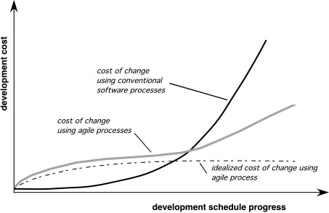
Agility and the Cost of Change

Slide 20
Agile Process
Is driven by customer descriptions of what is required (scenarios)
Recognizes that plans are short-lived
Develops software iteratively with a heavy emphasis on construction activities
Delivers multiple ‘software increments’
Adapts as changes occur

Slide 21
Agility Principles
Our highest priority is to satisfy the customer through early and continuous delivery of valuable software.
Welcome changing requirements, even late in development. Agile processes harness change for the customer's competitive advantage.
Deliver working software frequently, from a couple of weeks to a couple of months, with a preference to the shorter timescale.
Business people and developers must work together daily throughout the project.
Build projects around motivated individuals. Give them the environment and support they need, and trust them to get the job done.
The most efficient and effective method of conveying information to and within a development team is face–to–face conversation.

Slide 22
Agility Principles
Working software is the primary measure of progress.
Agile processes promote sustainable development. The sponsors, developers, and users should be able to maintain a constant pace indefinitely.
Continuous attention to technical excellence and good design enhances agility.
Simplicity – the art of maximizing the amount of work not done – is essential.
The best architectures, requirements, and designs emerge from self–organizing teams.
At regular intervals, the team reflects on how to become more effective, then tunes and adjusts its behavior accordingly.

